Slide 1
OpenDSS V8 and OpenDSS-G
Davis Montenegro Engineer/Scientist III
UCF OpenDSS Workshop July 26-27, 2018 Orlando, FL

Slide 2
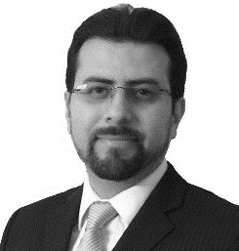
Instructor
Davis Montenegro, Member, IEEE
Davis Montenegro-Martinez serves as Engineer/Scientist III at the Electric Power Research Institute (EPRI) in the areas of power system modeling, analysis and high performance computing. He received his degree in electronics engineering from Universidad Santo Tomás, Bogotá, Colombia (2004); he is M.Sc. in electrical engineering from Universidad de los Andes, Bogotá , Colombia (2012). He received his Ph.D. in electrical engineering from Universidad de los Andes (2015), and a Ph.D. in electrical engineering from the University Grenoble-Alpes, France (2015).
Before joining EPRI, Davis served for 10 years as a lecturer for Universidad Santo Tomas in Colombia, during this time he was also technology consultant in the areas of industrial automation, software and electronic hardware design focused in the electric power industry, specifically in monitoring and control for meter calibration laboratories. His expertise in parallel computing techniques is being used at EPRI for incorporating multi-core processing to power system analysis methods such as QSTS, reducing the computational time required to perform these analysis using standard computing architectures

Slide 3
THE FUTURE OF OpenDSS

Slide 4


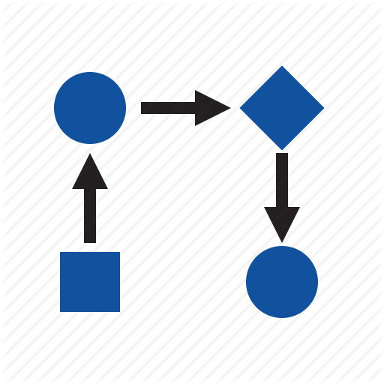

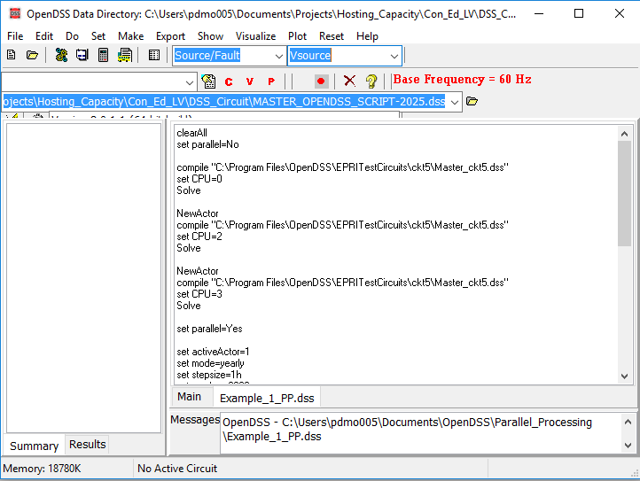
The evolution of OpenDSS into a parallel computing machine
After being released in 2008 as open source software OpenDSS has become widely used around the world. One of the features that makes OpenDSS popular is that the package offers interfaces for co-simulation.

Slide 5
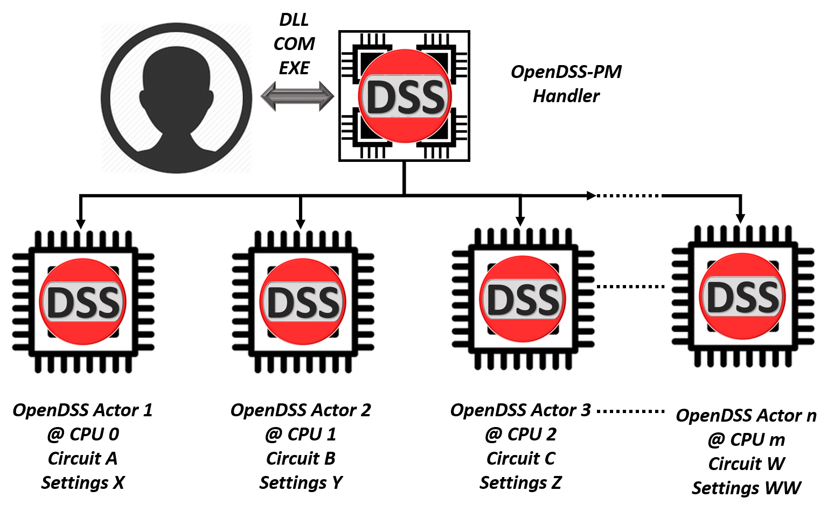
The evolution of OpenDSS into a parallel computing machine

Slide 6
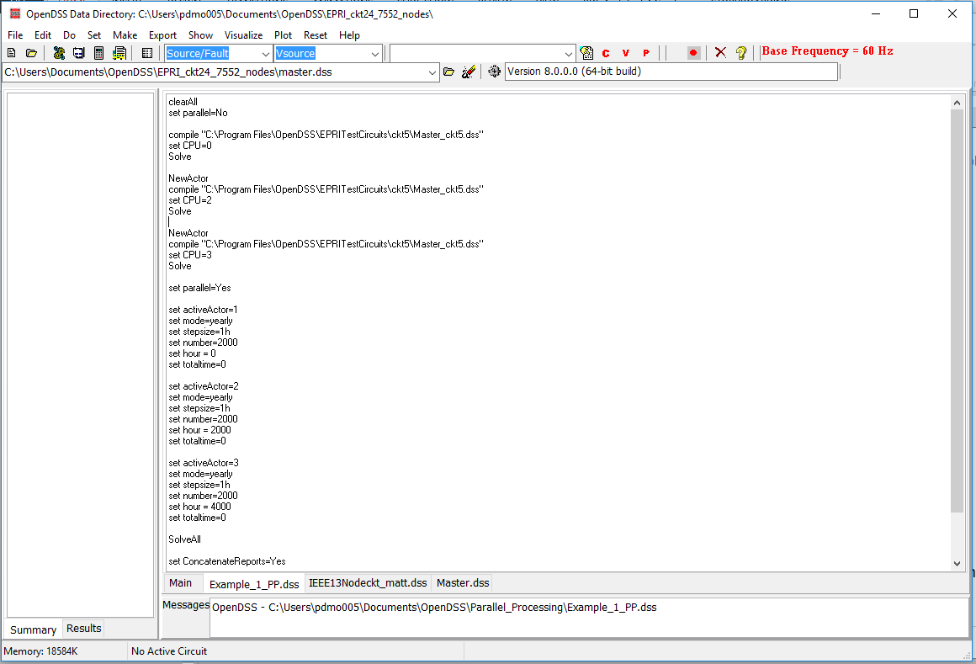

The evolution of OpenDSS into a parallel computing machine
These features have been implemented into the existing interfaces preserving the format and adding instructions to the instruction set

Slide 7
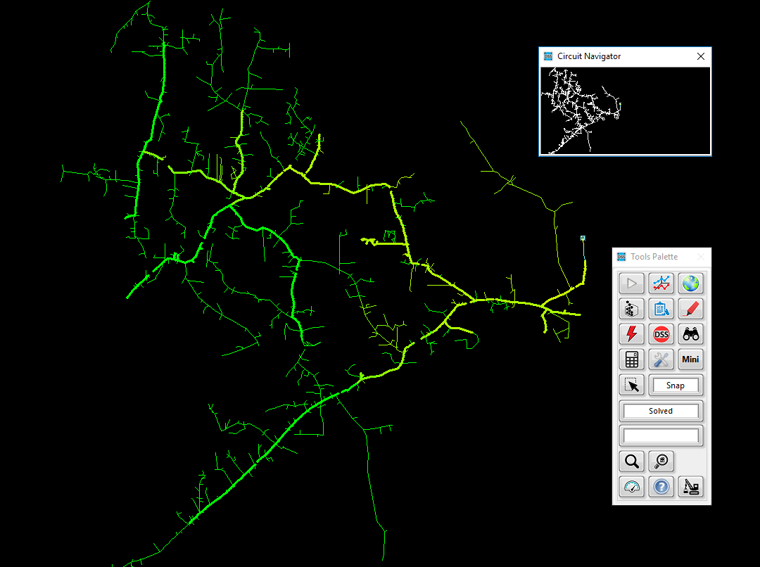


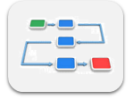


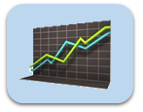

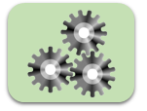
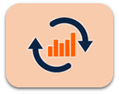

The evolution of OpenDSS into a parallel computing machine
TCP/IP Server
OpenDSS-G
Dbus

Slide 8
The evolution of OpenDSS into a parallel computing machine
There is a new set of functions and instructions related with parallel processing, topology analysis and more that can be used using the same DSS command environment
NumCPUs | ClearAll | Tear_Circuit
NumCores | Wait | Export IncMatrix
NewActor | Parallel | Export IncMatrixRows
NumActors | SolveAll | Export IncMatrixCols
ActiveActor | ConcatenateReports | Export BusLevels
CPU | CalcIncMatrix | Init_Diakoptics
ActorProgress | ClacIncMatrix_o | Refine_BusLevels
Abort

Slide 9
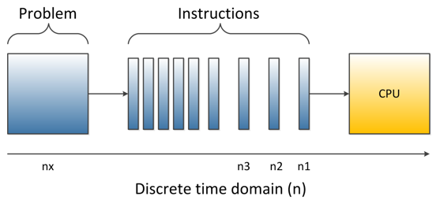
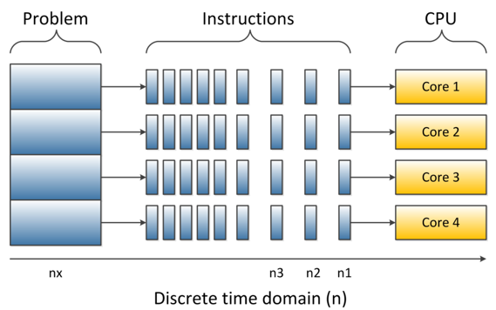
How far can you get with your computer in multi-core
Depending on your computer features and the understanding that you have about them it will depend how far can you go with parallel processing

Slide 10
How far can you get with your computer in multi-core
Thread 0 (CPU)
Core
Thread 1 (CPU)
Depending on your computer features and the understanding that you have about them it will depend how far can you go with parallel processing

Slide 11
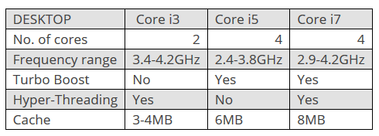

How far can you get with your computer in multi-core
CPU 1
CPU 0
Core
http://www.trustedreviews.com/opinion/best-intel-processor-core-i3-i5-i7-2937692
Depending on your computer features and the understanding that you have about them it will depend how far can you go with parallel processing

Slide 12
How far can you get with your computer in multi-core
CPU 0
Core
CPU 0
CPU 1
CPU 2
Core
CPU 2
CPU 3
Depending on your computer features and the understanding that you have about them it will depend how far can you go with parallel processing

Slide 13
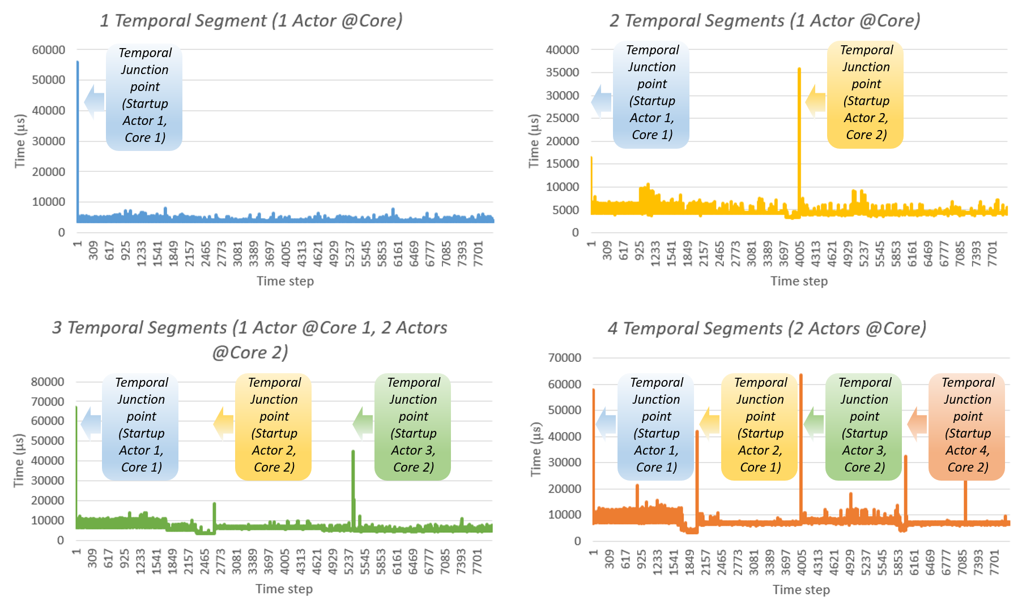
Parallel processing in OpenDSS What can I do with it?
Temporal Parallelization

Slide 14
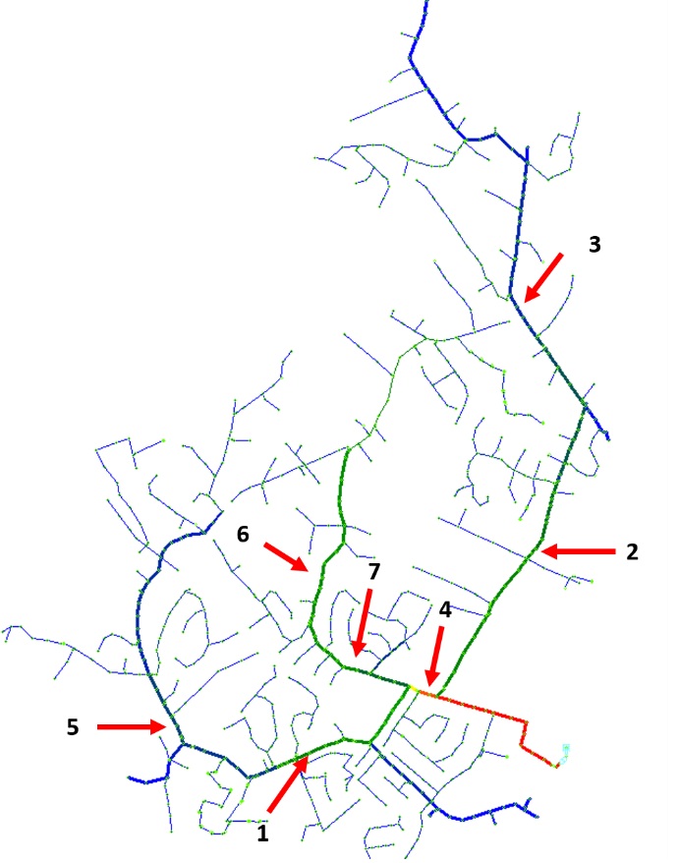
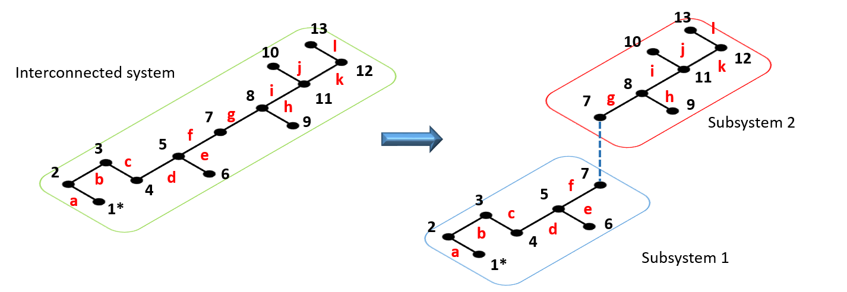
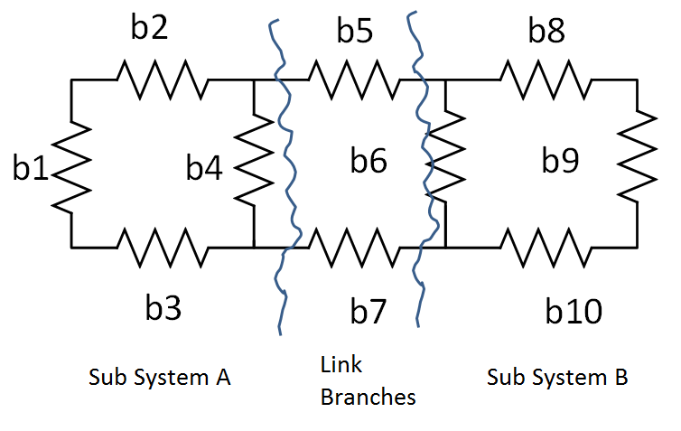
Parallel processing in OpenDSS What can I do with it?
Spatial Parallelization

Slide 15
Starting a parallel computing simulation
clearAll
set parallel=No
! Starts with Actor 1
compile "C:\Program Files\OpenDSS\EPRITestCircuits\ckt5\Master_ckt5.dss"
set CPU=0
Solve
NewActor ! Creates Actor 2 and activates it
compile "C:\Program Files\OpenDSS\EPRITestCircuits\ckt5\Master_ckt5.dss"
set CPU=2
Solve
NewActor ! Creates Actor 3 and activates it
compile "C:\Program Files\OpenDSS\EPRITestCircuits\ckt5\Master_ckt5.dss"
set CPU=3
Solve
set parallel=Yes
…

Slide 16
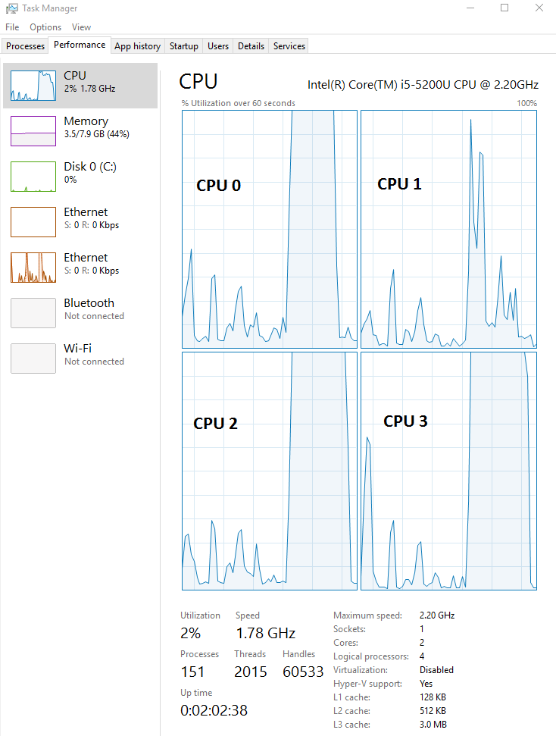
Starting a parallel computing simulation
…
set activeActor=1
set mode=yearly stepsize=1h number=2000 hour = 0 totaltime=0
set activeActor=2
set mode=yearly stepsize=1h number=2000 hour = 2000 totaltime=0
set activeActor=3
set mode=yearly stepsize=1h number=2000 hour = 4000 totaltime=0
SolveAll
Wait
set ConcatenateReports=Yes
show monitor MS2

Slide 17
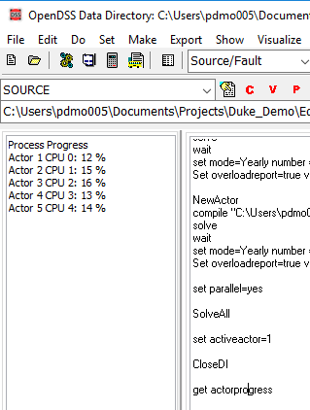
Parallel in OpenDSS means concurrently
…
set activeActor=1
set mode=yearly stepsize=1h number=2000 hour = 0 totaltime=0
set activeActor=2
set mode=yearly stepsize=1h number=2000 hour = 2000 totaltime=0
set activeActor=3
set mode=yearly stepsize=1h number=2000 hour = 4000 totaltime=0
SolveAll
get actorprogress

Slide 18
Parallel in OpenDSS means concurrently
…
set activeActor=1
set mode=yearly stepsize=1h number=2000 hour = 0 totaltime=0
set activeActor=2
set mode=yearly stepsize=1h number=2000 hour = 2000 totaltime=0
set activeActor=3
set mode=yearly stepsize=1h number=2000 hour = 4000 totaltime=0
SolveAll
Wait
set ConcatenateReports=No
set activeActor=1
show monitor MS2
set activeActor=2
show monitor MS2 …

Slide 19
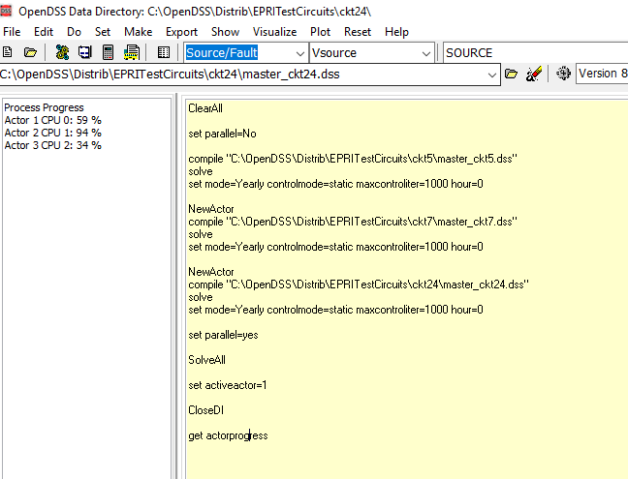
Parallel in OpenDSS means concurrently

Slide 20
Parallel processing in OpenDSS using COM
The examples for parallel processing can be downloaded from:
https://sourceforge.net/p/electricdss/code/HEAD/tree/trunk/Parallel_Version/Distrib/Examples/Parallel_Processing/
These examples involves MATLAB and python.
Other examples for LabVIEW through the VI Package Manager

Slide 21
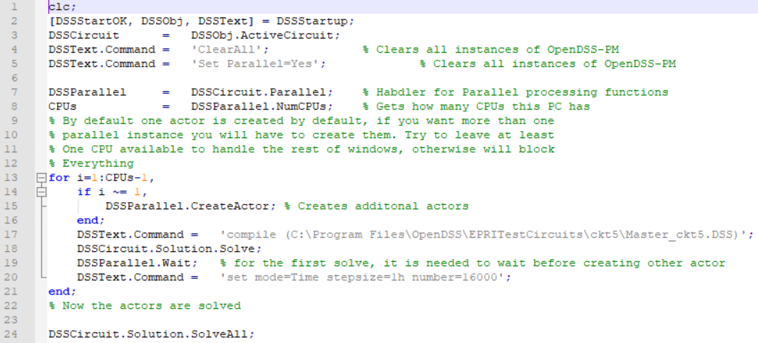
Parallel processing in OpenDSS using COM
Example # 1 MATLAB

Slide 22
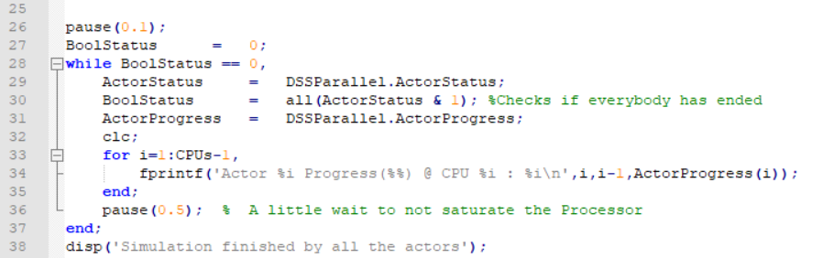
Parallel processing in OpenDSS using COM
Example # 1 MATLAB

Slide 23
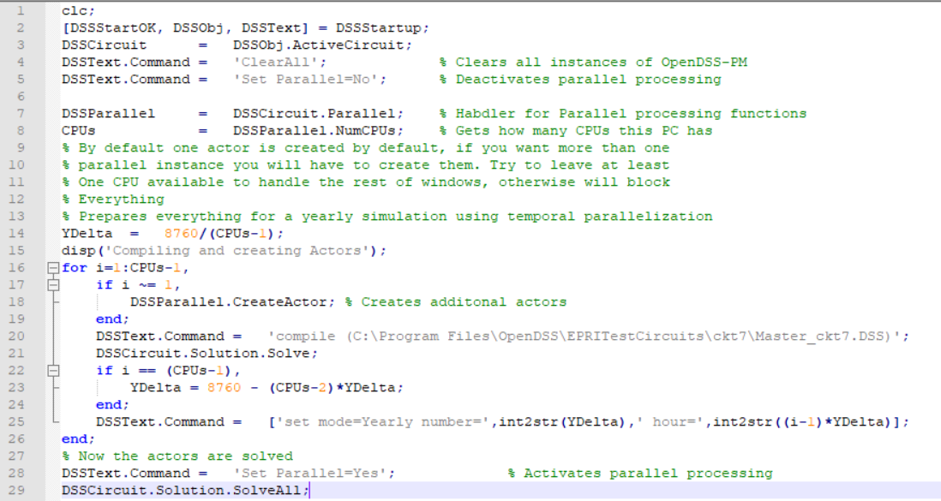
Parallel processing in OpenDSS using COM
Example # 2 MATLAB

Slide 24
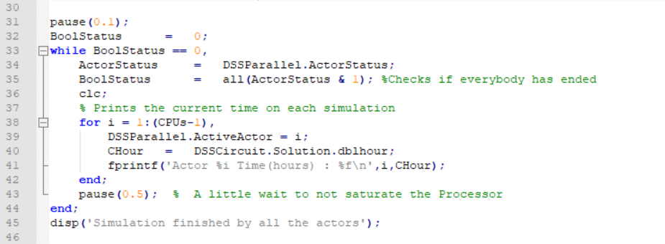
Parallel processing in OpenDSS using COM
Example # 2 MATLAB

Slide 25
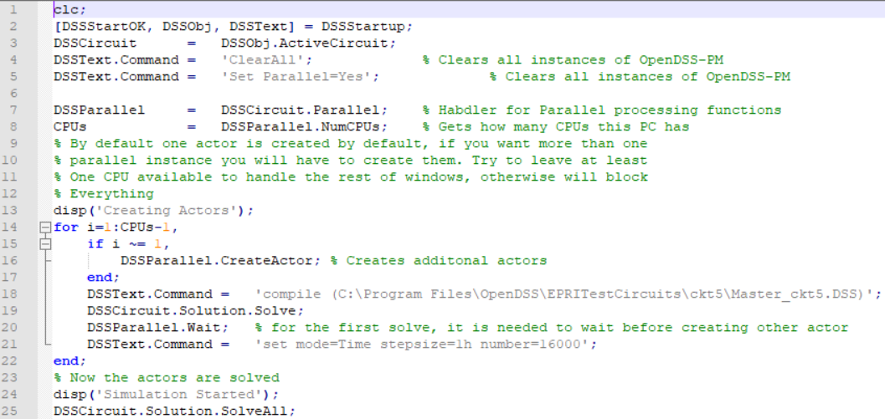
Parallel processing in OpenDSS using COM
Example # 3 MATLAB

Slide 26
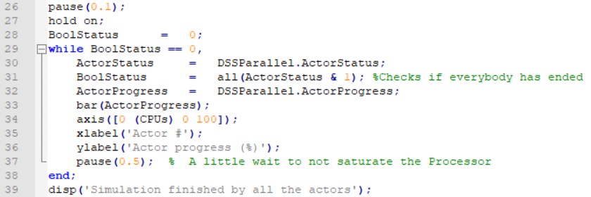
Parallel processing in OpenDSS using COM
Example # 3 MATLAB

Slide 27
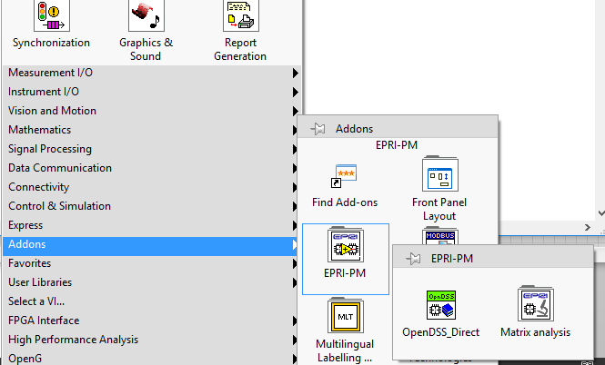
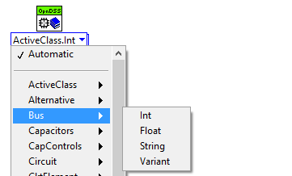
Parallel processing in OpenDSS using DirectDLL
Using the OpenDSS-PM library for NI LabVIEW

Slide 28

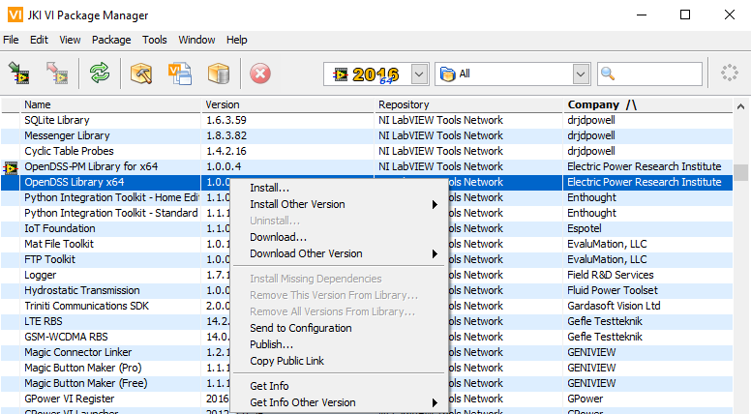
Parallel processing in OpenDSS using DirectDLL
Using the OpenDSS-PM library for NI LabVIEW

Slide 29
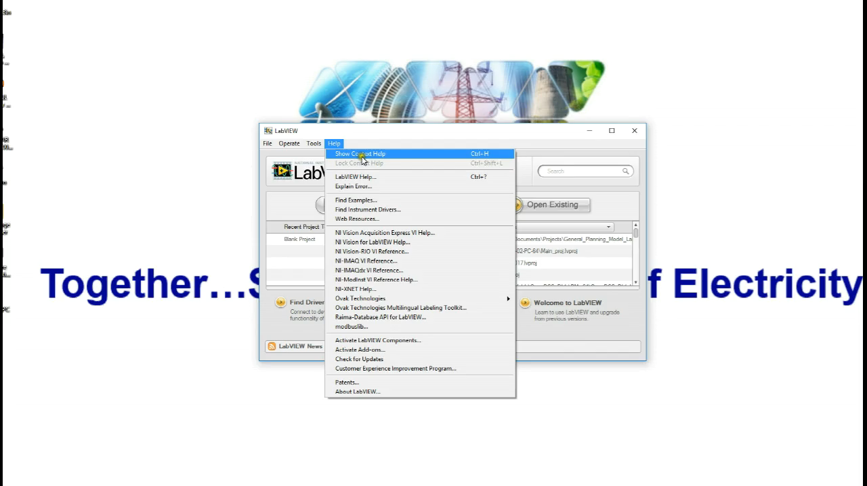
Parallel processing in OpenDSS using DirectDLL

Slide 30
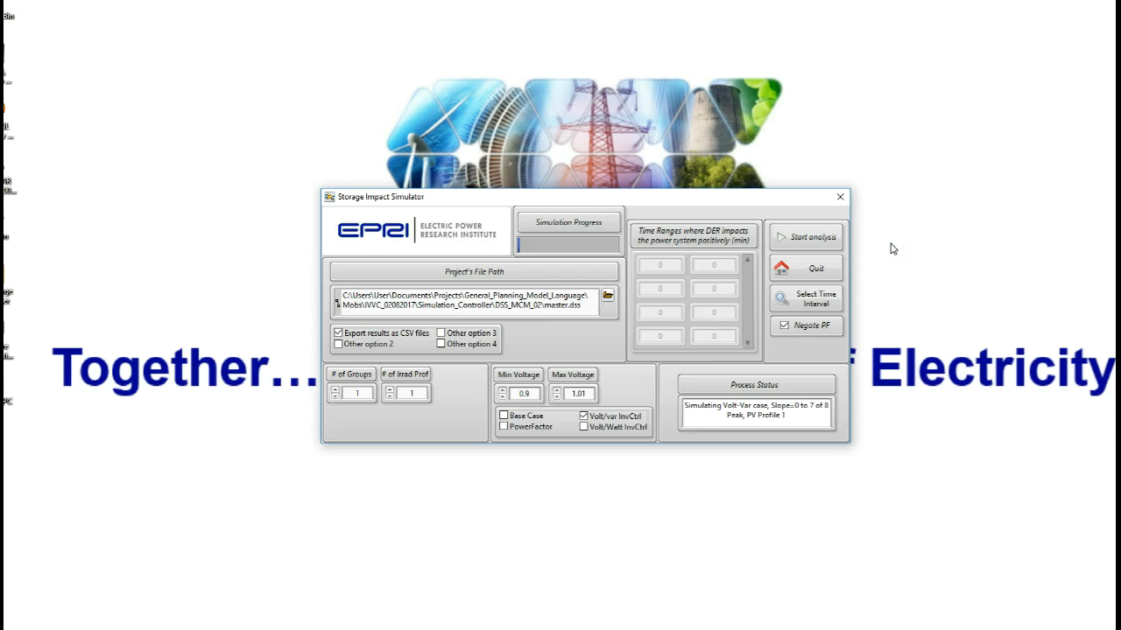
Parallel processing in OpenDSS using DirectDLL

Slide 31
Complementary Tools
Advanced Graphics Module for OpenDSS (OpenDSS-Viewer)
Developed by Miguel Hernandez (EPRI). Enhance the visualization of Distribution System Simulations with a flexible, scalable and meaningful approach.
https://epri.box.com/s/o4itfn23txv73iyo3y1ukbs9nmgsspgo

Slide 32
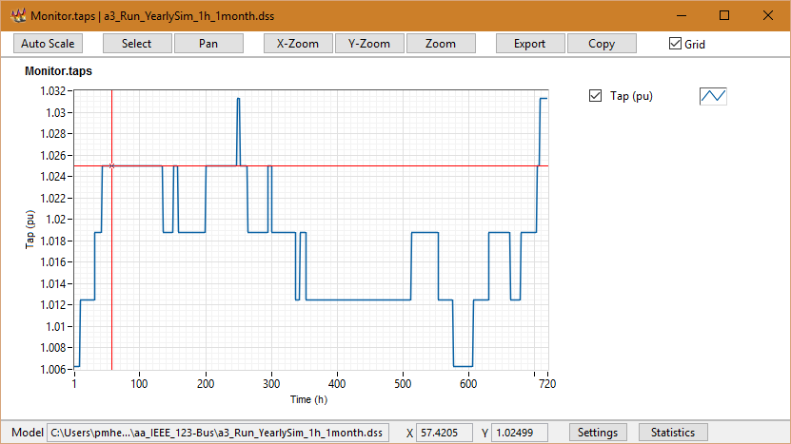
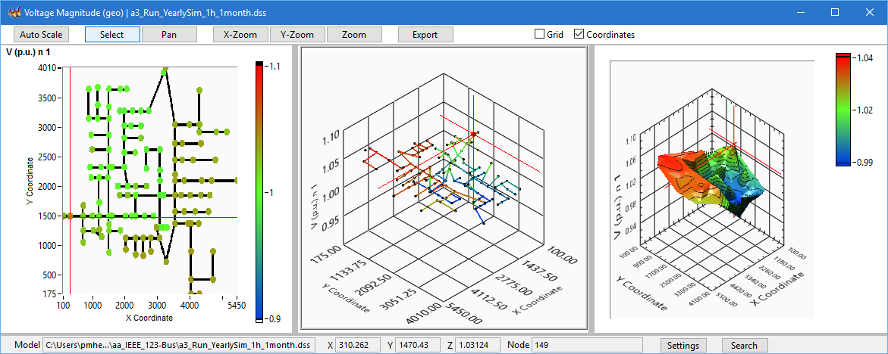
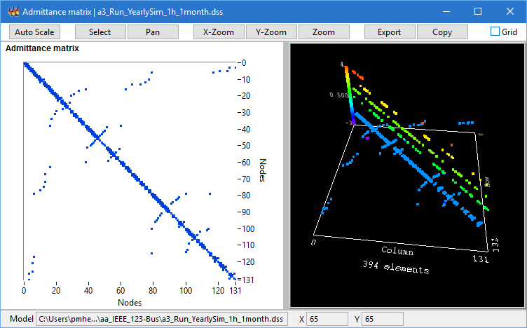
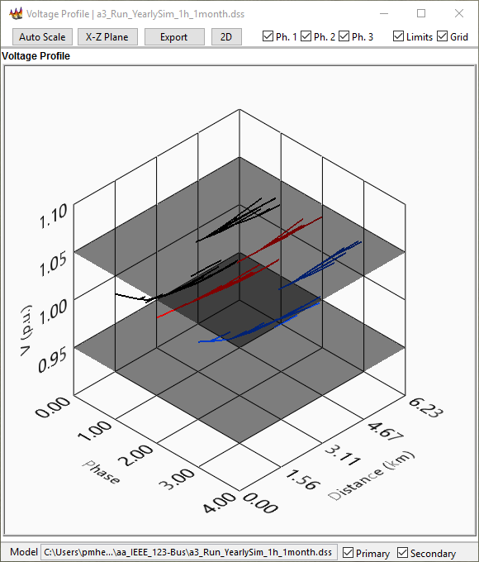
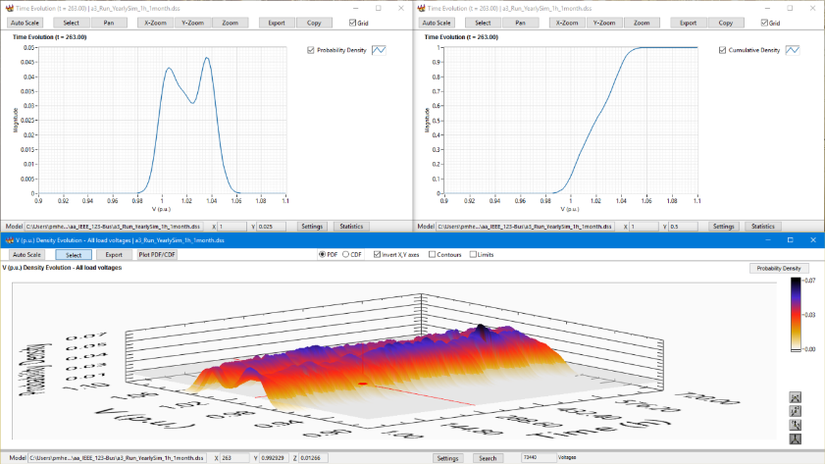
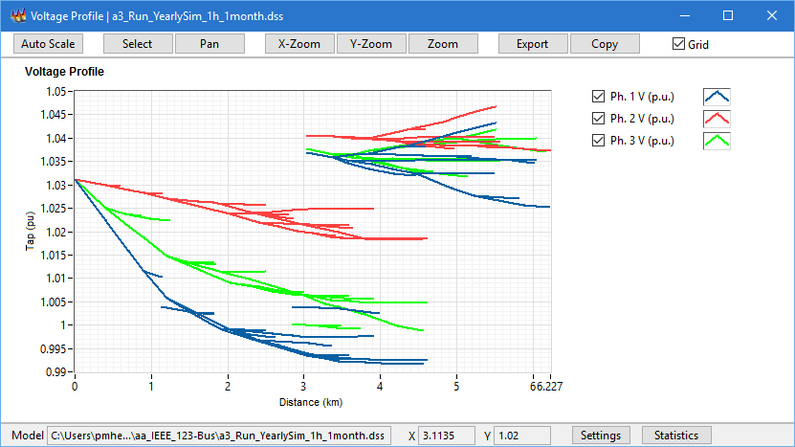
Complementary Tools

Slide 33
Complementary Tools
Demos

Slide 34
Questions

Slide 35
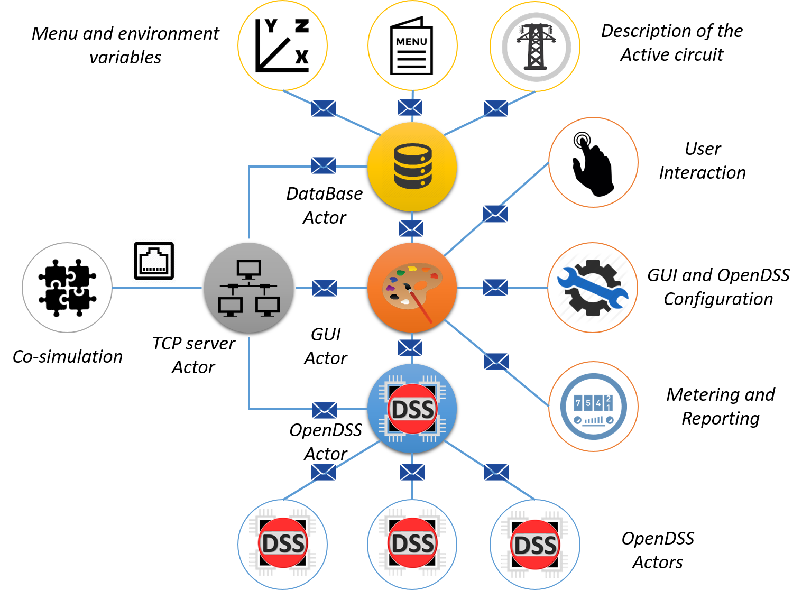
Introduction to OpenDSS-G

Slide 36
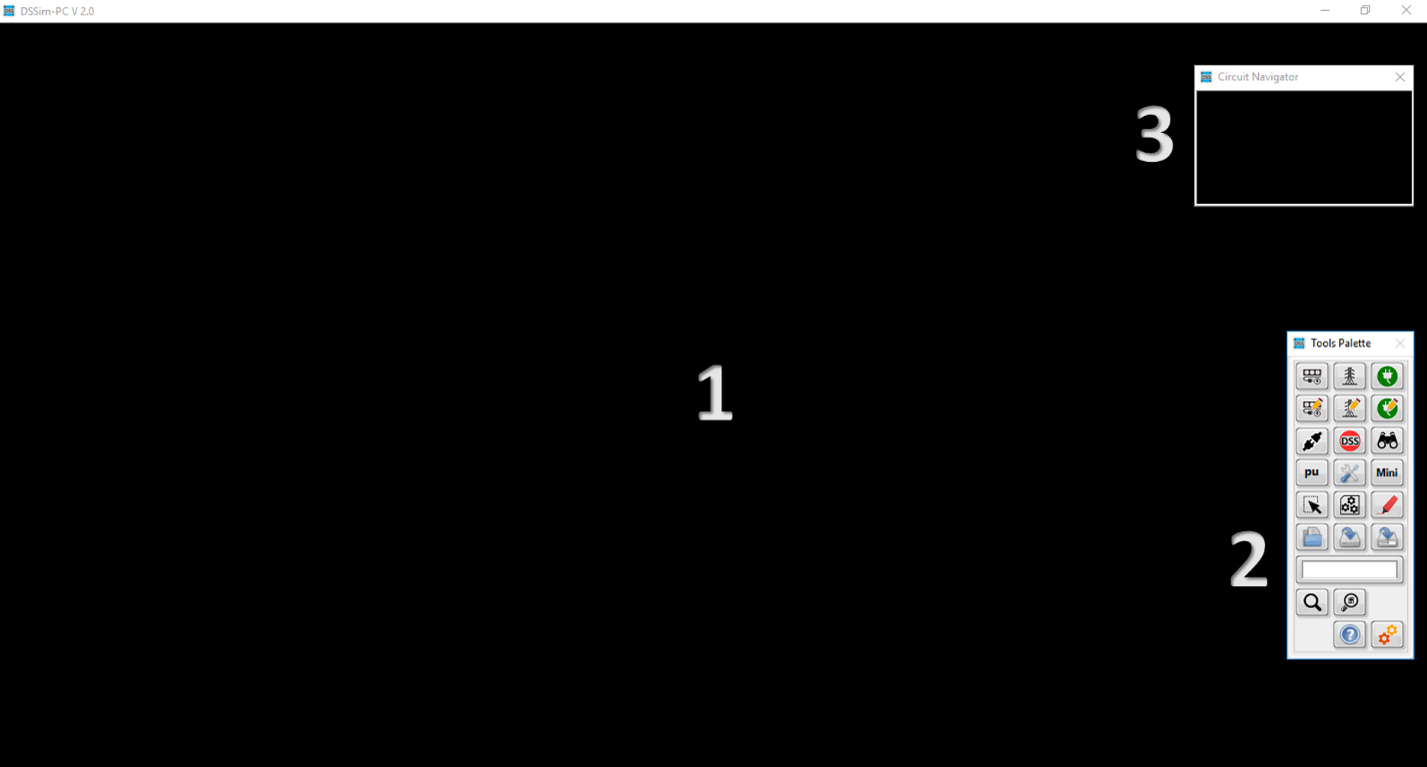
Introduction to OpenDSS-G

Slide 37
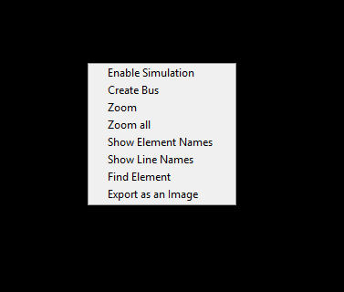
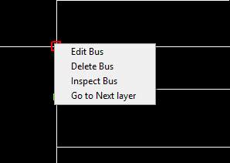
Introduction to OpenDSS-G

Slide 38
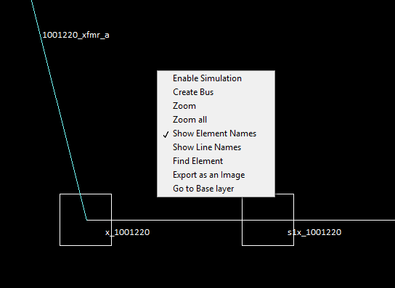
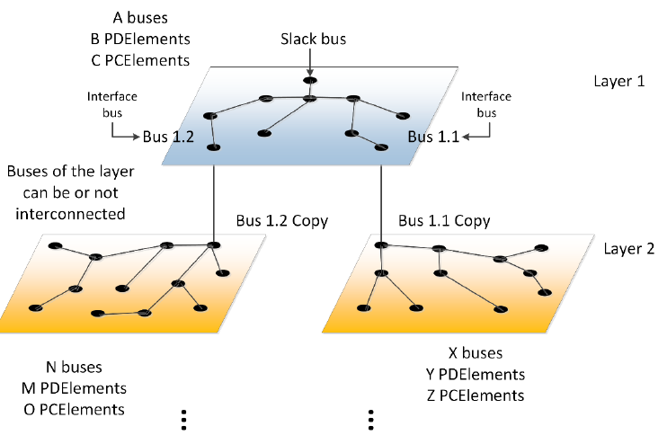
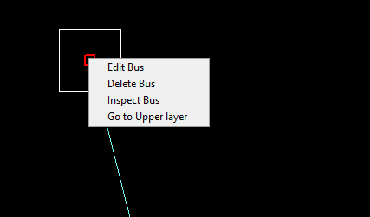
Introduction to OpenDSS-G

Slide 39
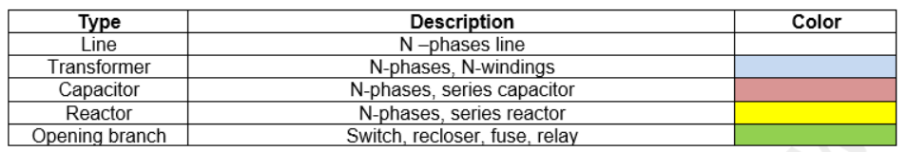
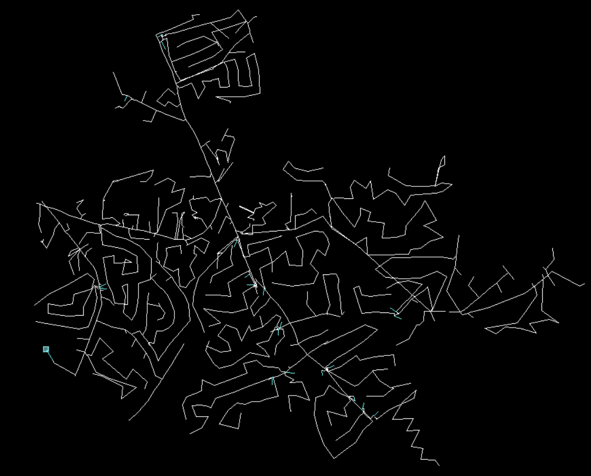
Introduction to OpenDSS-G

Slide 40
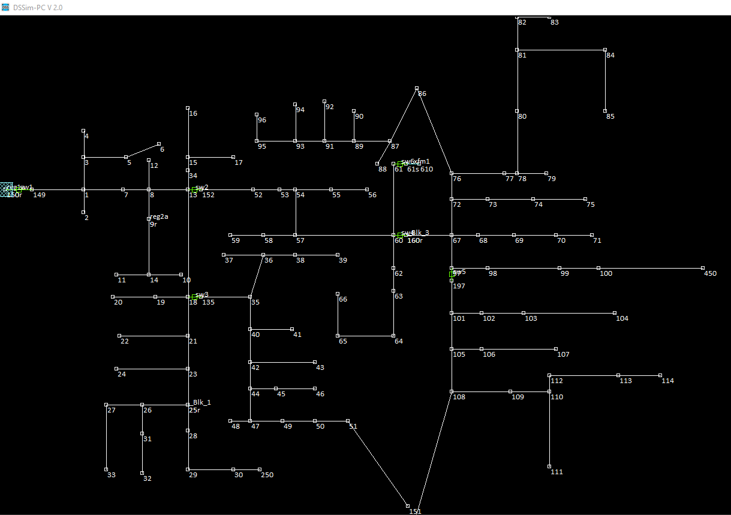
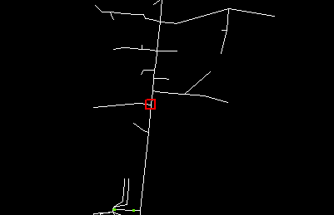
Introduction to OpenDSS-G

Slide 41
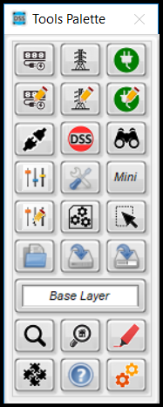
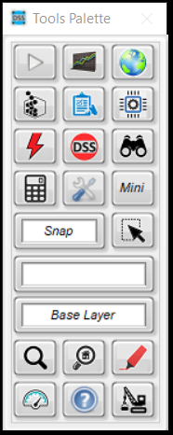
Introduction to OpenDSS-G

Slide 42


Introduction to OpenDSS-G

Slide 43



Introduction to OpenDSS-G

Slide 44

Introduction to OpenDSS-G

Slide 45

Introduction to OpenDSS-G

Slide 46


Introduction to OpenDSS-G

Slide 47



Introduction to OpenDSS-G

Slide 48


Introduction to OpenDSS-G

Slide 49


Introduction to OpenDSS-G

Slide 50
Introduction to OpenDSS-G
Demos

Slide 51
Creating your model
You have 2 options:
Importing an existing model
Describing your circuit from the scratch

Slide 52
Before anything
Download the examples to be used in this session:
https://sourceforge.net/p/dssimpc/code/HEAD/tree/trunk/Distribution/Examples/

Slide 53


Importing a model

Slide 54




Importing a model

Slide 55
Importing a model
Live Demo

Slide 56

Creating the model from the scratch

Slide 57


Creating the model from the scratch

Slide 58
Creating the model from the scratch
Rules:
Connect your PD/PCElement to an existing bus
Follow the instructions

Slide 59

Creating the model from the scratch
Transformers (special case):

Slide 60

Creating the model from the scratch
Transformers (special case):

Slide 61
Creating the model from the scratch
Live Demo

Slide 62

Other possibilities
Update your model (DSSim-PC)

Slide 63
Using OpenDSS-G (Simulation
Let’s simulate

Slide 64
Using OpenDSS-G (Simulation
Today’s examples:
Using Storage devices
Yearly Simulations and parallel processing
Real-time Simulation
Checking regulators and protections coordination
Using the FLISR programmer

Slide 65
Using OpenDSS-G (Simulation
Live Demo

Slide 66
Before anything
Download the examples to be used in this session:
https://sourceforge.net/p/dssimpc/code/HEAD/tree/trunk/Distribution/Examples/

Slide 67
First Example
Playing with Smart inverters

Slide 68
Second Example
Harmonics simulation

Slide 69



Co-Simulation
OpenDSS-G Incorporates a TCP server for distributed applications

Slide 70

Co-Simulation

Slide 71
Co-Simulation
Documentation:
https://sourceforge.net/projects/dssimpc/files/Documents/DSTCP-Comm.pdf/download
https://sourceforge.net/projects/dssimpc/files/Documents/MATLAB_Lib.pdf/download

Slide 72
Co-Simulation
MATLAB Example

Slide 73
Co-Simulation
LabVIEW Example

Slide 74
Changing the language of your local installation

Slide 75
Changing the language of your local installation
Documentation:
https://sourceforge.net/projects/dssimpc/files/Documents/Changing_the_language_of_OpenDSS-G.pdf/download
https://sourceforge.net/projects/dssimpc/files/Documents/Changing_the_language_of_OpenDSS-G-menus.pdf/download

